Slide 1

Course Name: Hardware Security
Faculty Name: Prof Debdeep Mukhopadhyay
Department : Computer Science and Engineering
Topic
Lecture 05: Finite Field Architectures-1 (Contd.)

Slide 2

Concepts Covered:
Karatsuba Multipliers
Modulo Operation in GF(2)

Slide 3
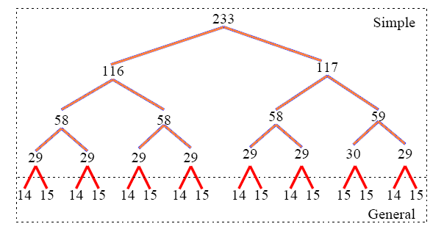
Example
233 bit Hybrid Karatsuba Multiplier

Slide 4
Module Multiplier in Verilog
module multiplier(a, b, d);
input wire [232:0] a;
input wire [232:0] b;
output wire [232:0] d;
wire [464:0] mout;
ks233 ks(a, b, mout); (Karatsuba Multiplier)
mod mod1(mout, d); (Modulo Operation)
endmodule

Slide 5
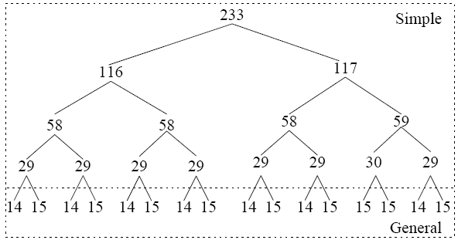
Karatsuba Multiplier
The multiplier operates on 233 bit inputs and gives a 465 bit outputs.
The multiplier uses sub-multipliers, with operands as described in the figure.
The initial multipliers are Simple Karatsuba based, however after a threshold of 16, it was realized by Generalized Karatsuba blocks.

Slide 6
Module ks233
assign ahl[115:0] = a[232:117] ^ a[115:0];
assign ahl[116] = a[116];
assign bhl[115:0] = b[232:117] ^ b[115:0];
assign bhl[116] = b[116];
ks117 ksm3(ahl, bhl, m3);
endmodule
module ks233(a, b, d);
input wire [232:0] a; input wire [232:0] b;
output wire [464:0] d;
wire [230:0] m1; wire [232:0] m2;
wire [232:0] m3;wire [116:0] ahl; wire [116:0] bhl;
ks117 ksm1(a[116:0], b[116:0], m2);
ks116 ksm2(a[232:117], b[232:117], m1);

Slide 7
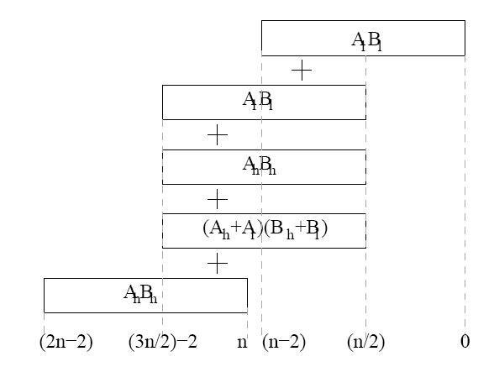
Combining the Partial Results
Since, n=233:
d[0…116] = m2[0…116]
d[117…232]=m2[117…232] ^ m2[0..115] ^ m1[0…115] ^ m3[0…115]
d[233]=m2[116]^m1[116]^m3[116]
d[234…347]=m2[117…230]^m1[117…230]^m3[117…230]^m1[0…113]
d[348] = m2[231] ^ m3[231] ^ m1[114]
d[349] = m2[232] ^ m3[232] ^ m1[115]
d[350…464]=m1[116…232]

Slide 8
Generalized Karatsuba
A(x)=a₂x²+a₁x+a_{0,} B(x)=b₂x²+b₁x+b₀
D₀=a₀b₀, D₁=a₁b₁, D₂=a₂b₂
D_{0,1}=(a₀+a₁)(b₀+b₁), D_{0,2}=(a₀+a₂)(b₀+b₂)
D_{1,2}=(a₁+a₂)(b₁+b₂)
A(x)*B(x)
=D₂x⁴+(D_{1,2}-D₁-D₂)x³+(D_{0,2}-D₀-D₂+D₁)x²+(D_{0,1}-D₀-D₁)x+D₀

Slide 9
The Generalized Karatsuba Codes
module ks14(a, b, d) and module ks15(a, b, d)
uses this idea for 14 and 15 degree polynomials.
Details can be found in the verilog code:
http://cse.iitkgp.ac.in/~debdeep/osscrypto/eccpweb/downloads/ksgen_verilog.tar.gz

Slide 10
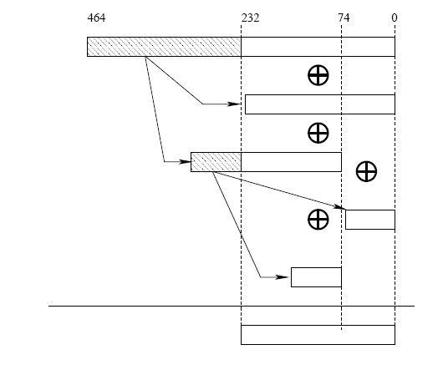
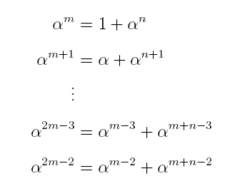
Modulo Operation
Multiplication and squarer will lead to overflow.
Hence we need to perform a modulo operation to bring the result in the field
Modulo Polynomial:
x²³³+x⁷⁴+1
Here, m=233 and n=74
(Note: n < m/2)

Slide 11


Slide 12
Conclusion:
We studied few important finite field operations in characteristic 2:
Karatsuba Multipliers
Squaring
Modulo Operation

Slide 13


